Slide 1
Software Engineering Sprint 3 Presentation
Traffic Challan Management
Team ID: B04
15UCS154 – Utsav Singh (PO)
15UCS108 – Rishabh Tiwari
15UCS121 – Satyam Kumar
15UCS122 – Satyam Shubham
15UCS138 – Shubham Mangal (SM)

Slide 2
Project purpose
To reduce difficult paperwork of challan generation by traffic officer,
to efficiently generate challan and reduce the time consumed in manual work,
to provide better traffic regulations, and
to provide online platform for offenders to pay fine.

Slide 3
Project overview
Traffic Challan Management system provides the following functionality:
Offers the data about commuters using their vehicle’s license number,
Penalize the road rules offenders by issuing the challan against the vehicle’s license number,
Helps the traffic officer to manage and regulate the challan generation automatically and hassle free,
Provide platform to pay the challan fine amount online

Slide 4
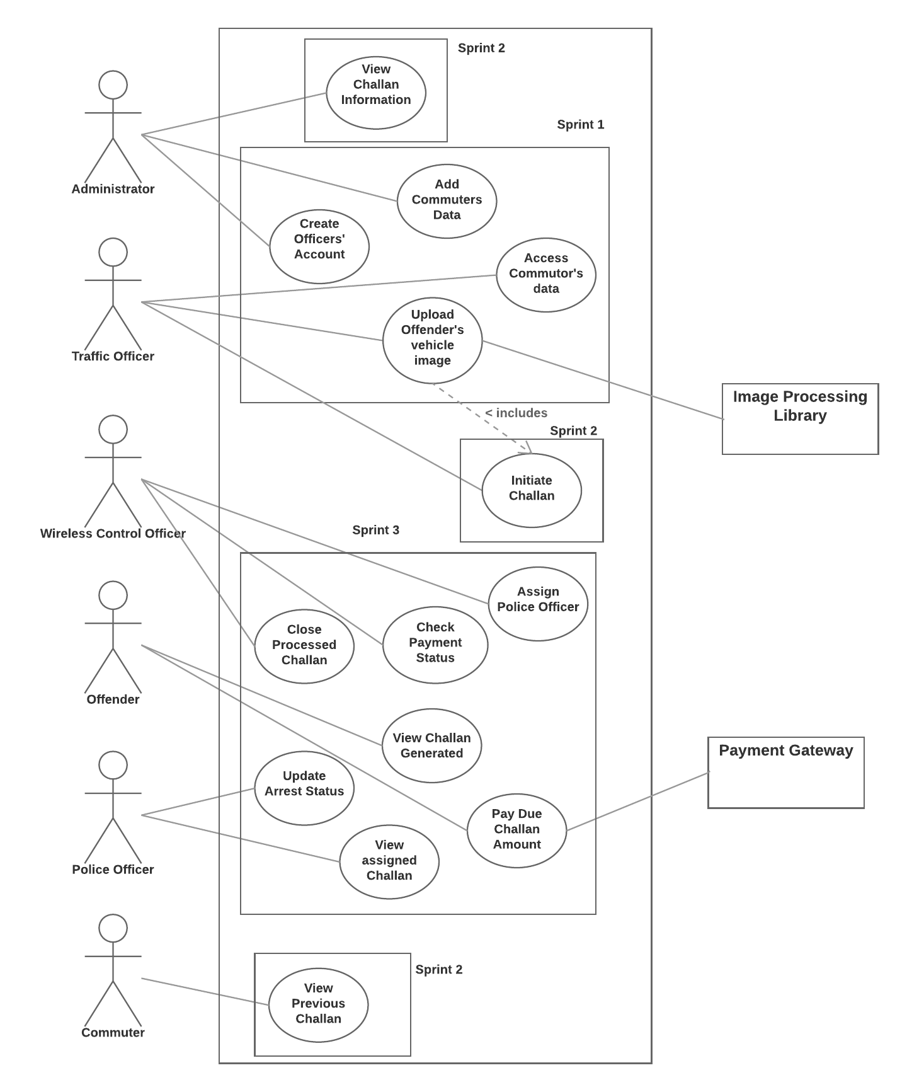
Use case diagram

Slide 5
Use case diagram (sprint 3 use cases)

Slide 6
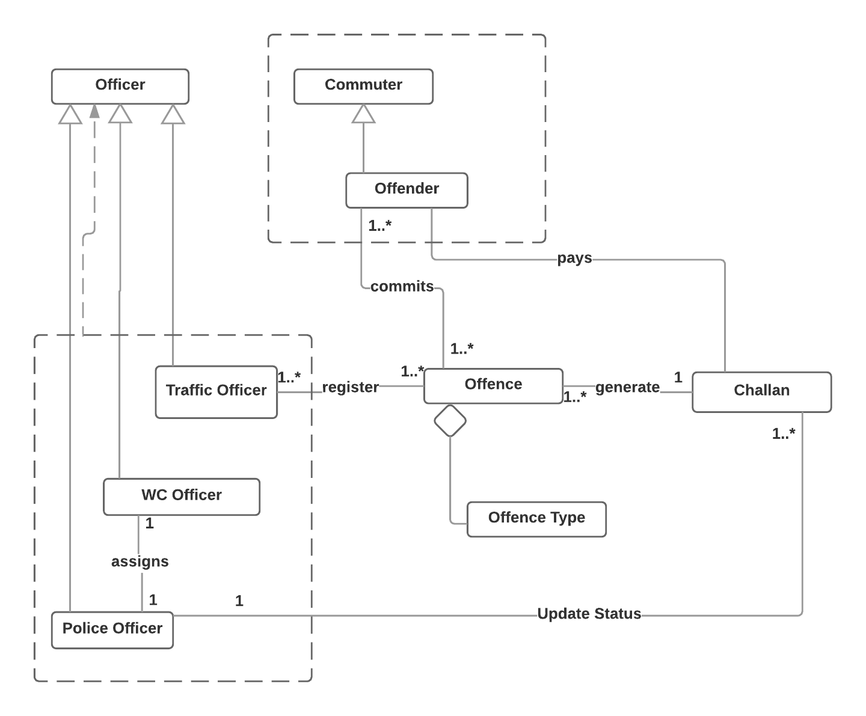
Class diagram

Slide 7
Demonstration Link
Admin Access to Insights of Challan Data
Uploading image and initiating Challan
Payment of Challan

